Slide 1
NHL Goalie Save Percentages
The Unbelievably Fascinating World of

Slide 2
Background
Determining forward performance is easy: offensive output, shot generation
Less so for defenders, harder to quantify depriving scoring chances, but can use shot share metrics and similar offensive output
Goalies are more difficult to analyze and, in particular for a variety of reasons

Slide 3
Background
Individual game performances are highly sensitive to teammate quality, the opposing roster, and random events.
Winning outcomes don’t necessarily imply good future performance
Projecting future NHL performance from different leagues is particularly challenging – NHL GMs have not figured this out
Save percentage is the most consistent box score stat for determining a goalie’s contribution to a particular game

Slide 4
Focus
Given that save percentage describes a goalie’s repeatable skill more or less accurately*, what other factors might influence it?
Target: Career Save percentage
Goal: Find some useful relationship between other standard attributes and career save percentage, or that there isn’t one

Slide 5
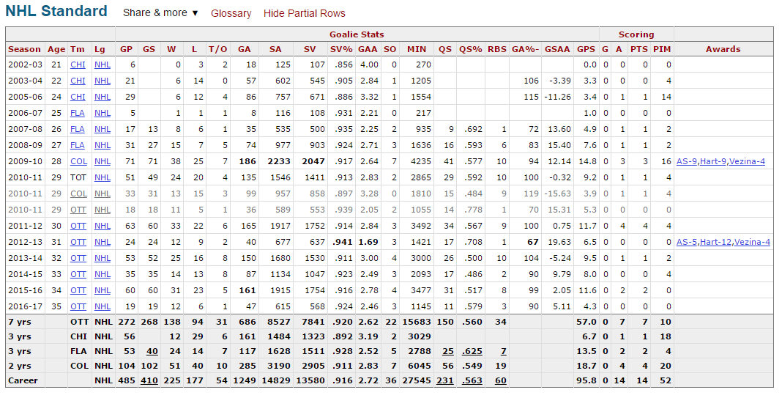
Data
Scrubbed from www.hockey-reference.com using Python

Slide 6
Data
From 1984-2017 – save percentage not tracked before 1984
Goalies had to have played more than 80 games
Goalies who played most of their career before percentages were tracked were included as a concession to data gathering complexity*
227 observations, 46 variables
2 identification, 16 statistical, remaining 28 represent Hall of Fame teammates

Slide 7
Data
Vitals: Height, Weight, Starting Age, Age at final season
Range of seasons played
Games played, minutes played, wins, losses
Total shots faced, career save percentage, career high single season save percentage
Quality starts metric, bad starts, ratio Q:B – thrown out
Defender matrix

Slide 8
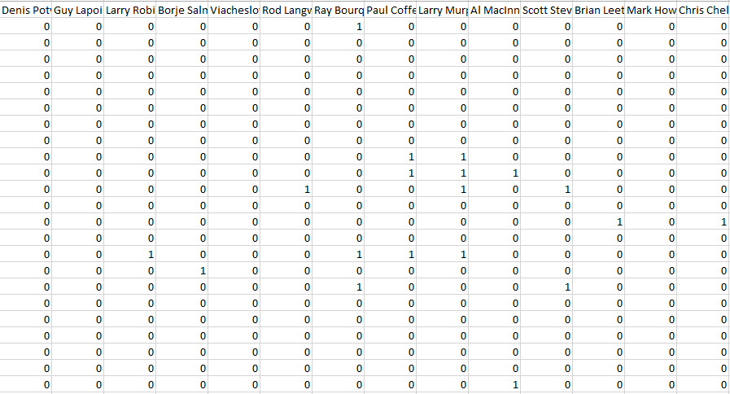
Data

Slide 9
Processing
Most done by script while gathering
Defense matrix was clumsy – just added them up
Not enough quality start data – stat wasn’t tracked until 2009
Some standardization…

Slide 10
Summary stats
Career save % range: 0.811 – 0.925
Total shots: 160 – 31,709
GP: 81 – 1266
Hall of Fame teammates: Median: 1
Earliest season covered 1969 – not explicitly in data, but, for goalies who overlapped the beginning of shot tracking and met games played requirement, set save % as measured in time tracked

Slide 11
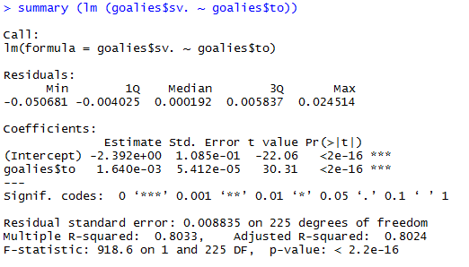
Early Analysis
Most significant by far year of first and final season

Slide 12
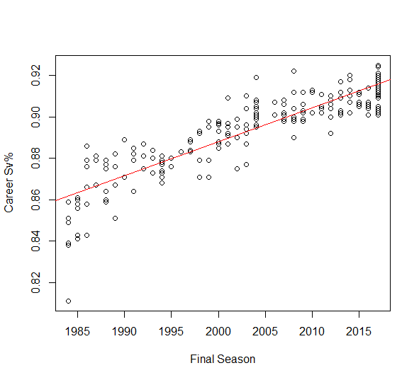

Slide 13
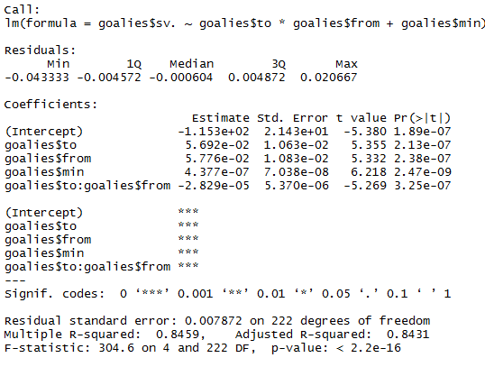
Early Analysis
Minutes played significant

Slide 14
Year and Save Percentage
Save percentages collectively better in current players
Not particularly interesting

Slide 15
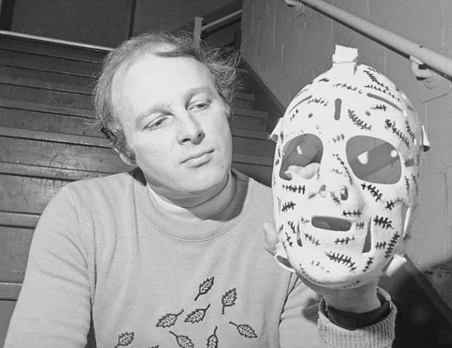

Slide 16
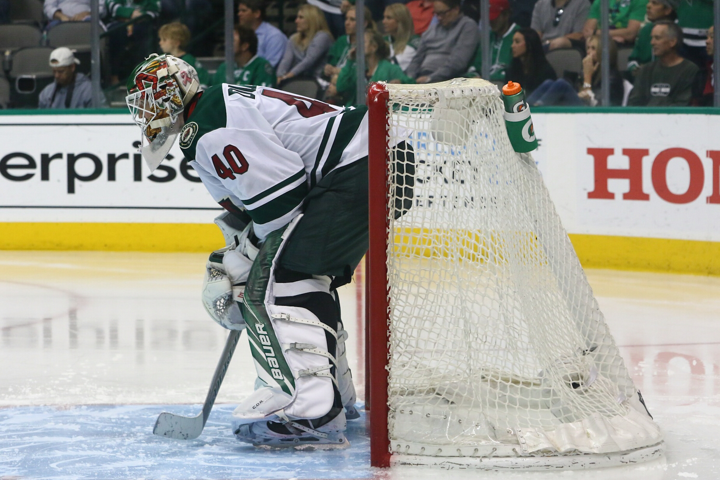

Slide 17
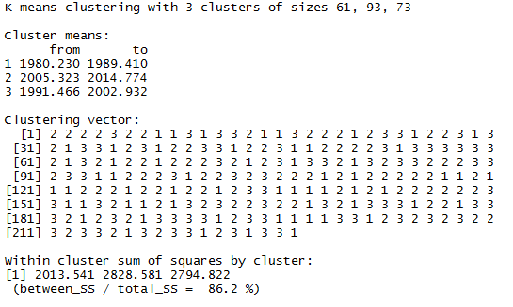
Cluster Analysis!

Slide 18
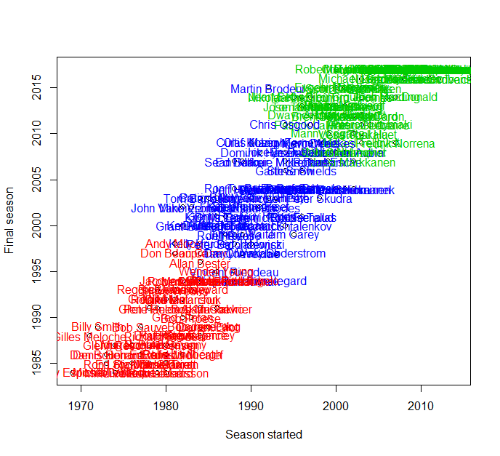

Slide 19
Clustering
Could have gone for more clusters, but n > 3 was harder to interpret
Didn’t make a lot of sense to further discretize to me, attempting to cluster to find a general peer group for standardization

Slide 20
Standardization
Computed z-scores within clusters to better enable comparison among goalies in different eras
Early cluster mean save%: 0.869
Middle cluster mean save%: 0.896
Contemporary cluster mean save%: 0.910

Slide 21
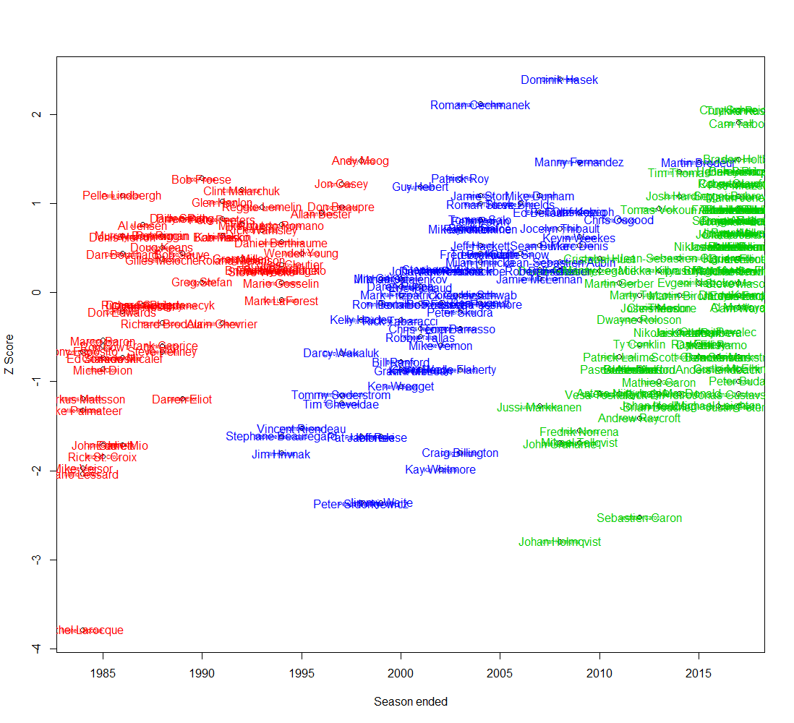

Slide 22
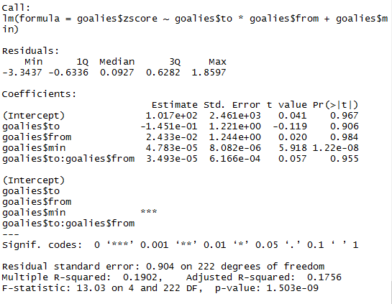
Things are complicated now

Slide 23
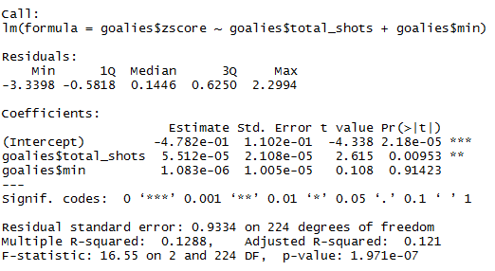
Minutes and Shots? I don’t know

Slide 24
Conclusions
Still need to try some predictive modeling
Going to see if regression trees do anything
Data might not be conducive to what I’m trying to look at
Hard to gauge a goalie’s skill without watching them, but NHL GMs also get that wrong, too, judging by results

Slide 25
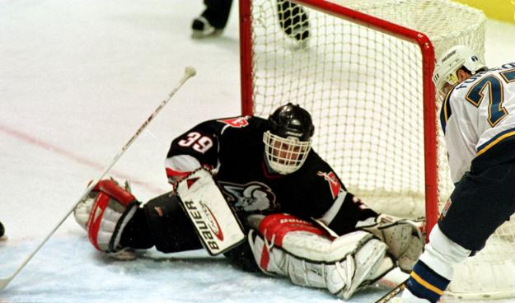
Dominik Hasek Is Awesome

